Slide 1


Cryptocurrency Value Prediction
RAJA ALFIQ IZRIN BIN RAJA ISMAIL MOKHTAR
WIH190020
Supervisor: DR. NOR LIYANA BT MOHD SHUIB

Slide 2
INTRODUCTION
A cryptocurrency (or “crypto”) is a digital currency that can be used to buy goods and services but uses an online ledger with strong cryptography to secure online transactions (Royal, 2018).
Bitcoin has been named as the most valuable asset of the previous decade.
This shows the potential of cryptocurrencies as a medium of investment for many out there, especially with the emergence of many alternative options such as Ethereum.

Slide 3
PROBLEM STATEMENT
The problem based on previous works on cryptocurrency prediction is that they mainly focus on only Bitcoin which is only one of the many cryptocurrencies (Iqbal et al., 2021).
Another problem based on previous works is that the data collected are not in real-time and are not flexible (Muniye et al., 2020).

Slide 4
LITERATURE REVIEW
Table 1
References | Objective | Dataset | Techniques | Limitations
Muniye et al., 2020 | Bitcoin Price Prediction and Analysis Using Deep Learning Models | Every Cryptocurrency Daily Market Price | long short-term memory (LSTM) and gated recurrent unit (GRU) | Dataset is static
Iqbal et al., 2021 | Time-Series Prediction of Cryptocurrency Market using Machine Learning Techniques | Bitcoin Historical Data | ARIMA, FBProphet, and XG Boosting | Dataset limited to just Bitcoin
Salman & Ibrahim, 2020 | Predicting changes in Bitcoin price using grey system theory | Bitcoin Historical Data | first order gray model (GM (1,1)) | Dataset limited to just Bitcoin Small sample size in implementation
Sebastião & Godinho, 2021 | Forecasting and trading cryptocurrencies with machine learning under changing market conditions | Daily data from Coin Metrics Site | Linear models, Random Forests, and Support Vector Machines | Low accuracy
Gullapalli, 2018 | Learning to predict cryptocurrency price using artificial neural network models of time series | Quandl API | time-delay neural networks (TDNN) and recurrent neural networks (RNN) | High Training Time

Slide 5
OBJECTIVE
To develop a model of a cryptocurrency price predictor.
To evaluate the accuracy.

Slide 6
Research Question
Are we able to predict the price of cryptocurrencies accurately?
How to evaluate the accuracy of the cryptocurrency price predictor?

Slide 7

Project Scope
The project scope will be to limit to only a few cryptocurrencies such as Bitcoin(BTC), Ethereum(ETH), Ripple(XRP), and Litecoin(LTC). This is because these 4 can be found in the Luno application as shown in Figure 1.
Figure 1

Slide 8
Target Users
Target users will be anybody who is highly interested in investing cryptocurrency. Investing in cryptocurrency does not have a limit as you can even test your investing skills with small amounts of money. This allows anyone to participate but typically people in their mid 20’s to late 30’s will be the main target users.

Slide 9
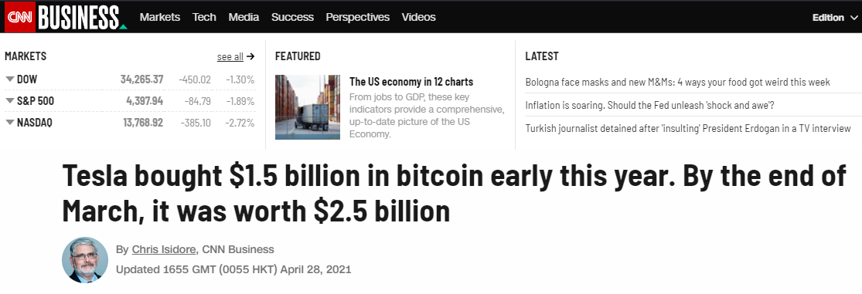
Potential Stakeholders
The potential stakeholders for this project should be any companies who wish to hold on to cryptocurrencies for investment purposes. One such example is Tesla which recently bought 1.5 billion dollars worth in bitcoin as shown in Figure 2 (Isidore, 2021).
Figure 2

Slide 10
Expected Outcome
Expected outcome will be that we have a somewhat accurate way of predicting the price of certain cryptocurrencies based on past trends.

Slide 11
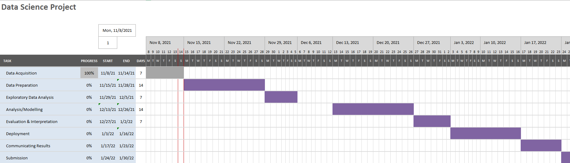
Project Timeline

Slide 12
METHODOLOGY

Slide 13
DATA COLLECTION
Data Acquisition
DATA
PREPROCESSING
Data Cleaning & Transformation
EXPLORATORY DATA ANALYSIS
Analysis Tool
MODEL
DEVELOPMENT
FBProphet
A tool to predict the future price of a cryptocurrency using the historical data of cryptocurrency
MODEL
EVALUATION
Improving Accuracy
TESTING &
DEPLOYEMENT

Slide 14
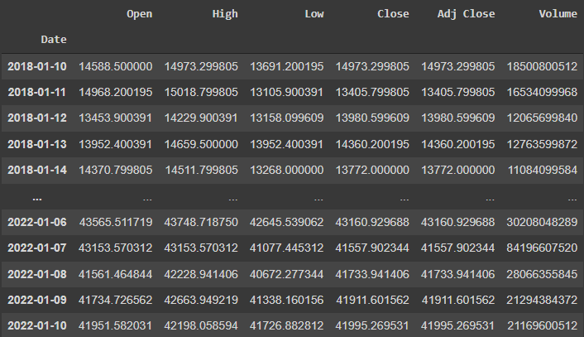
DATA COLLECTION SAMPLE
The data set is taken from the Yahoo Finance API and consists of the attributes: High, Low, Open, Close, Adj Close, and Volume.
Figure 3 shows the attributes for Bitcoin(BTC).
Figure 3

Slide 15
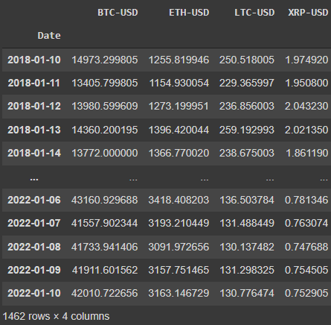
DATA PREPROCESSING
For the purpose of this project, only the attribute ‘Adj Close’ will be used. So the remaining attribute columns have been removed.
Due to the remaining attributes being removed, we can add more cryptocurrencies for comparison in this project.
Figure 4 shows the ‘Adj Close’ of 4 different cryptocurrencies.
Figure 4

Slide 16
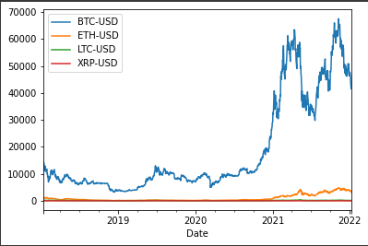
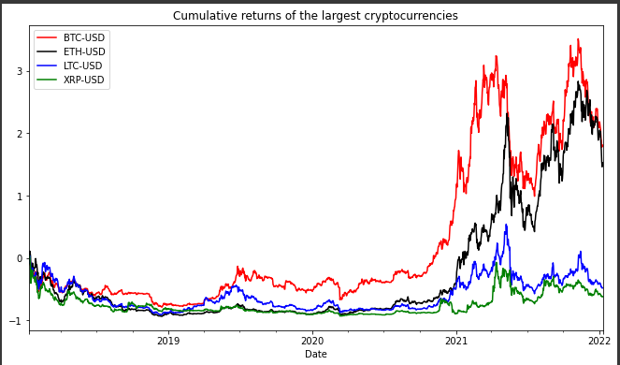
EXPLORATORY DATA ANALYSIS
As cryptocurrencies have different price points, it is senseless to make comparison based on their price like shown in Figure 5.
It is fair to compare the cumulative returns of each cryptocurrencies though as shown in Figure 6.
It can be seen that Bitcoin and Ethereum been performing a lot better than Ripple and Litecoin.
Figure 5
Figure 6

Slide 17
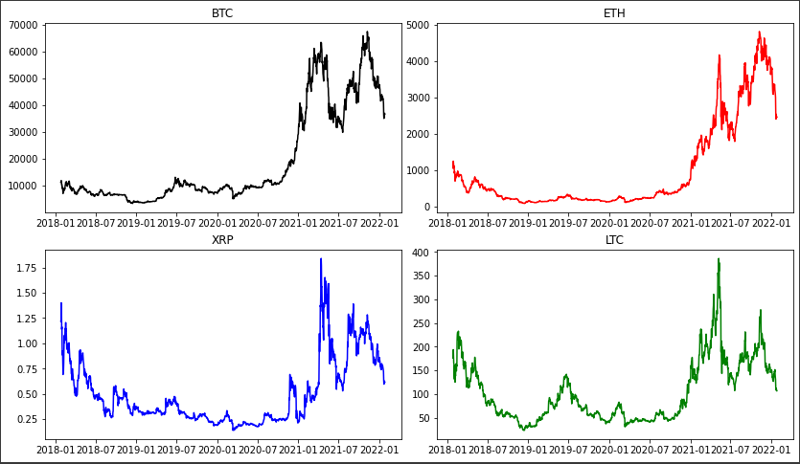
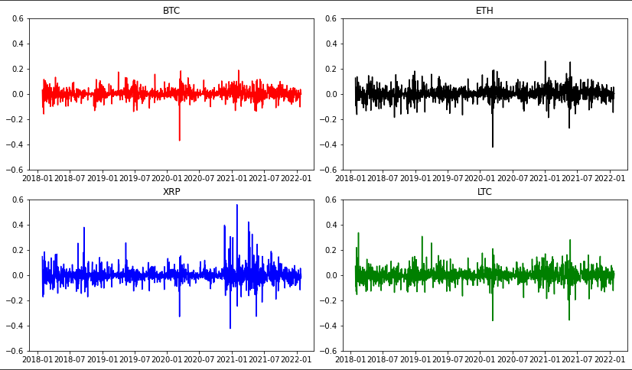
EXPLORATORY DATA ANALYSIS
Figure 7 shows the same as Figure 4 but as separate graphs, all 4 cryptocurrencies share a similar trend pattern.
Figure 8 shows the volatility of each cryptocurrencies daily price changes.
Figure 7
Figure 8

Slide 18
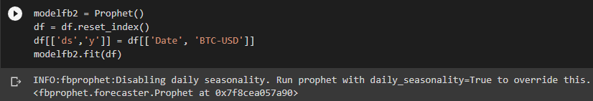
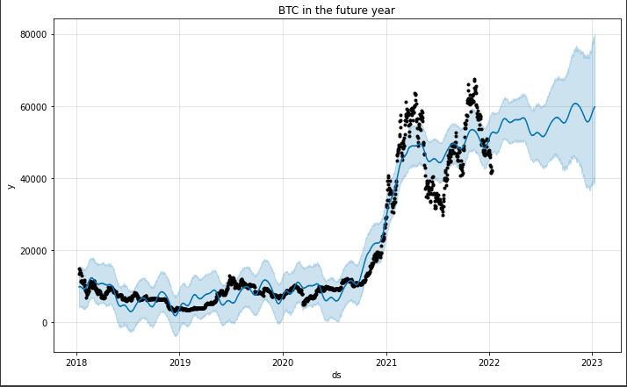
MODEL DEVELOPMENT
Facebook Prophet (FBProphet) model, which is an advanced open-source forecasting model built by Facebook, is used for the modeling.
Figure 9 shows the FBProphet model being used to predict the price of Bitcoin in the future year. Figure 10 shows the plot made to predict the price of BTC in the future year.
Figure 9
Figure 10

Slide 19
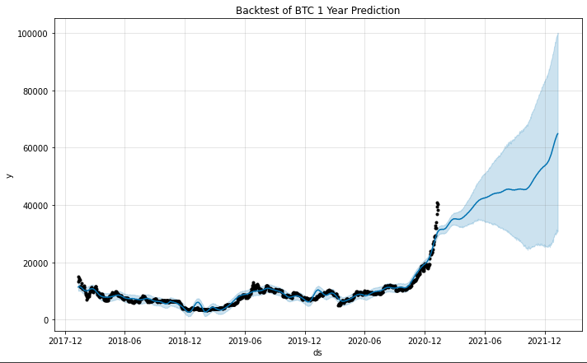
MODEL EVALUATION
To evaluate the accuracy of the cryptocurrency price predictor, I performed a back test of the price predictor in the previous year.
The purpose of the back test is to validate whether the price of cryptocurrency at current times are accurate based on past data.
Figure 11 shows the plot of the back test.
Figure 11

Slide 20
MODEL EVALUATION
The r-squared of the OLS regression model is used to determine how much Bitcoin price affects the other cryptocurrencies price.
Figure 12 is for ETH-BTC, Figure 13 is for XRP-BTC, and Figure 14 is for LTC-BTC.
Figure 12
Figure 13
Figure 14

Slide 21




TOOLS USED
The whole project was done in Google Colab and Python is used as the programming language.
The application however uses additional modules in the Google Colab namely Streamlit & Remoteit to be deployed.

Slide 22
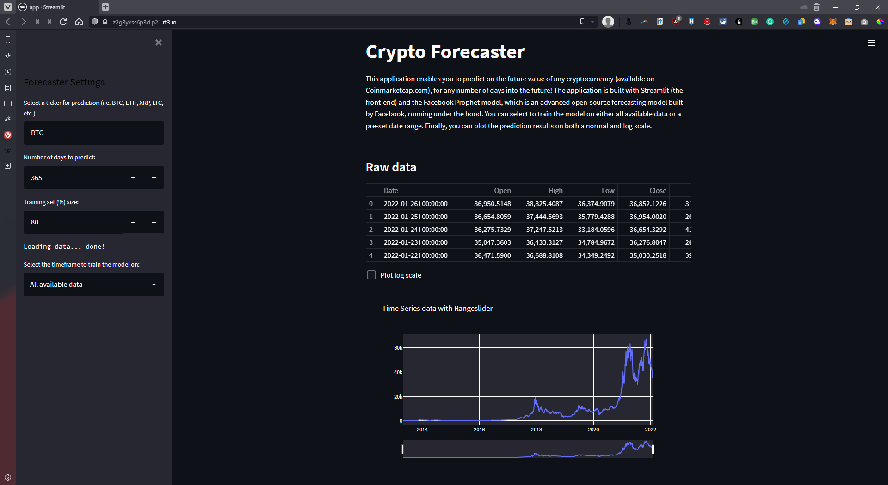
Application – Crypto Forecaster
https://z2g8ykss6p3d.p21.rt3.io/
Figure 15

Slide 23
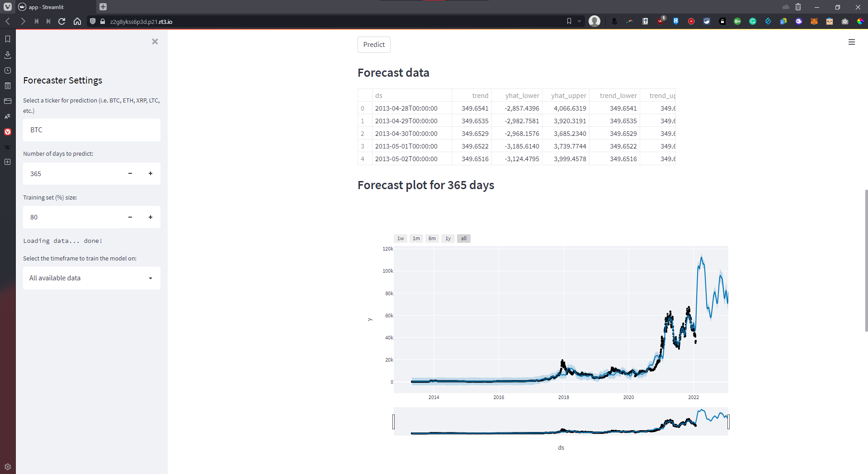
Application – Crypto Forecaster
Figure 16

Slide 24
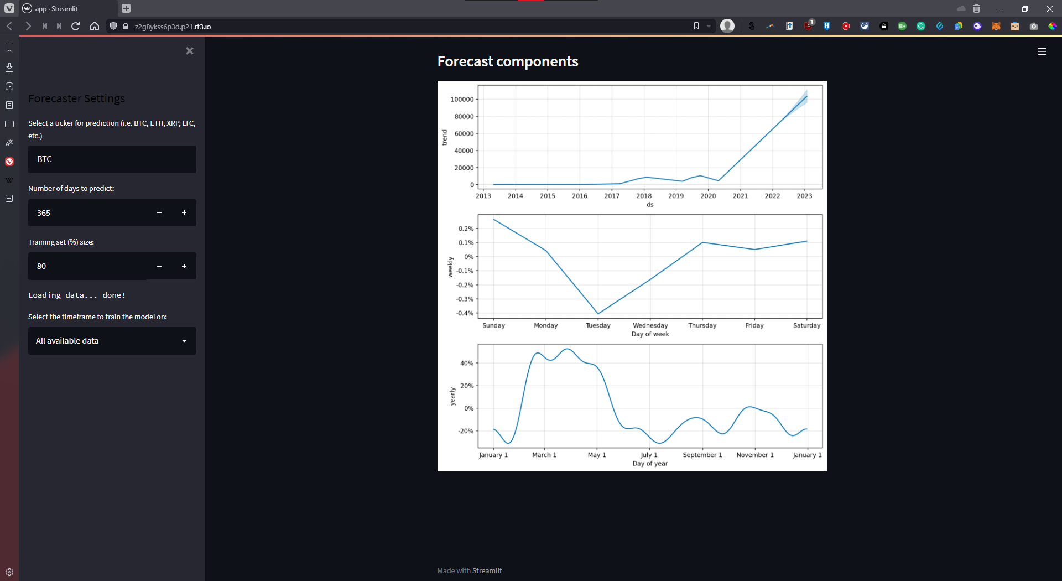
Application – Crypto Forecaster
Figure 17

Slide 25
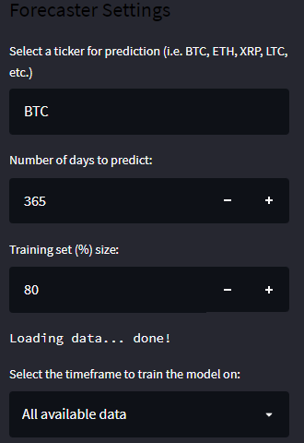
Application – Crypto Forecaster
Figure 18 shows the user input options.
The investor mainly has 4 input variables to manipulate.
Firstly is the ticker name of the cryptocurrency.
Secondly is the number of days to predict.
Thirdly is the training set to testing set ratio.
Lastly is the timeframe to train the model.
Figure 18

Slide 26

Application
User manual for the application

Slide 27
REFERENCES
Gullapalli, S. (2018). Learning to predict cryptocurrency price using artificial neural network models of time series. K-State.edu. https://doi.org/http://hdl.handle.net/2097/38867
Iqbal, M., Muhammad Shuaib Iqbal, Fawwad Hassan Jaskani, & Hassan, A. (2021, July 8). Time-Series Prediction of Cryptocurrency Market using Machine Learning Techniques. ResearchGate; European Alliance for Innovation n.o. https://www.researchgate.net/publication/353067843_Time-Series_Prediction_of_Cryptocurrency_Market_using_Machine_Learning_Techniques
Isidore, C. (2021, April 28). Bitcoin helps Tesla post record profits. Retrieved January 23, 2022, from CNN website: https://edition.cnn.com/2021/04/28/investing/tesla-bitcoin/index.html
Royal, J. (2018, January 11). What Is Cryptocurrency? Here’s What You Should Know. Retrieved November 14, 2021, from NerdWallet website: https://www.nerdwallet.com/article/investing/cryptocurrency-7-things-to-know#:~:text=A%20cryptocurrency%20(or%20%E2%80%9Ccrypto%E2%80%9D,at%20times%20driving%20prices%20skyward
Salman, M. K., & Ibrahim, A. A. (2020). Price prediction of different cryptocurrencies using technical trade indicators and machine learning. Retrieved January 7, 2022, from https://iopscience.iop.org/article/10.1088/1757-899X/928/3/032007
Sebastião, H., & Godinho, P. (2021). Forecasting and trading cryptocurrencies with machine learning under changing market conditions. Financial Innovation, 7(1). https://doi.org/10.1186/s40854-020-00217-x
‌Temesgen Awoke Muniye, Rout, M., Mohanty, L., & Suresh Satapathy. (2020, October). Bitcoin Price Prediction and Analysis Using Deep Learning Models. ResearchGate; unknown. https://www.researchgate.net/publication/345262720_Bitcoin_Price_Prediction_and_Analysis_Using_Deep_Learning_Models

